Slide 1


Last night,
just as I do every night before I have to wake up for school around 6am.
I studied until 2am,
I somehow managed to get to school on time today,
but getting through these past two class periods has been
extremely difficult.

Slide 2

off
fight
What am I doing wrong?
I kept having to sleep,
I can’t afford to get in trouble.
My grades already aren’t what they should be.
I don’t get it though,
I’m trying so hard.
I even study for tests I have later in the day in
my early class periods lunch.
AND
I should know this stuff.

Slide 3

Maybe I should’ve finished lunch...
or eaten breakfast,
but I’m using my time to stay “in the zone!”
So, I
should-d
be
Y?
That’s strange...
has that word always
excelllling.
WHy?
sounded like a letter?
NO!
I should know this stuff.
Focus.
It is now fifth period, and I NEED to take the test...
and pass it.
I studied .
hard

Slide 4
…
…
…
Woah.
Stop that, me.
Okay, my teacher is, finally, passing out the test.
I’m not sure what
Hopefully, he was saying we could retake the test if we don’t get a score we like.
he said before.
I kind of...
checked out for a second.
Something about retakes?

Slide 5
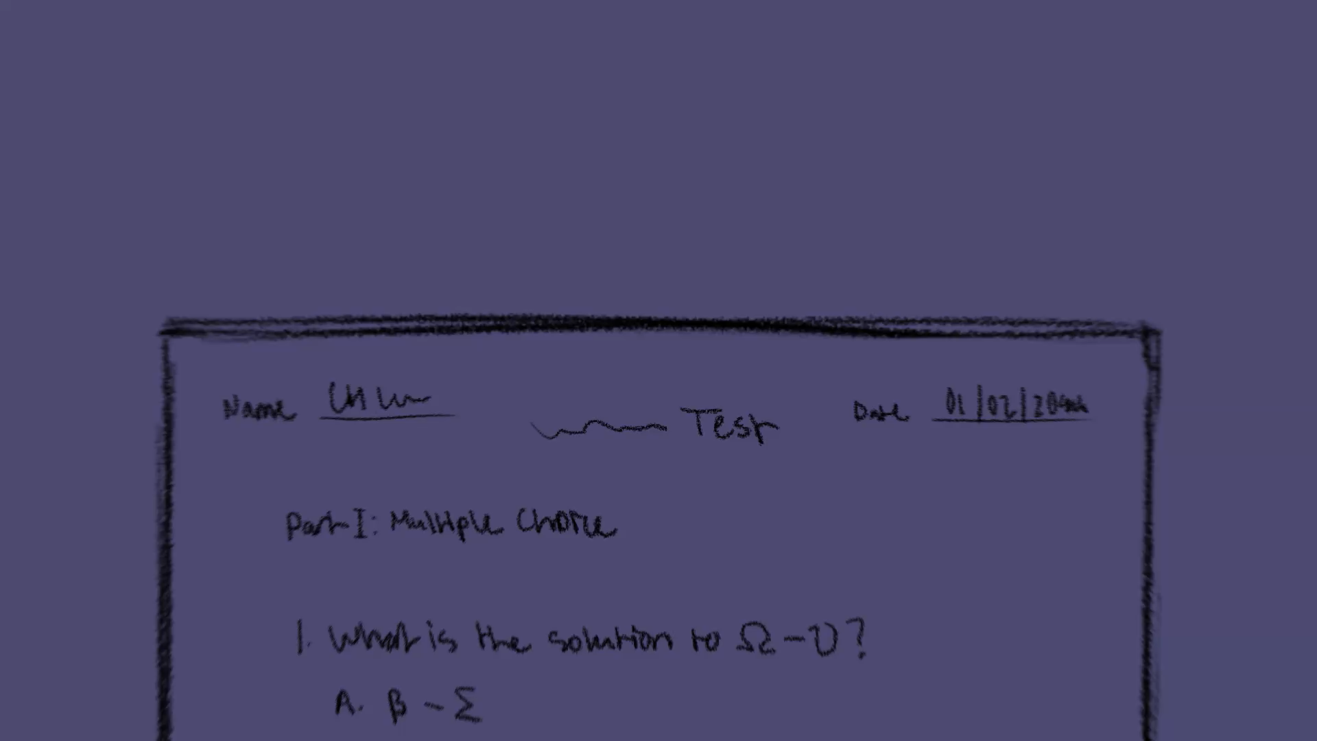
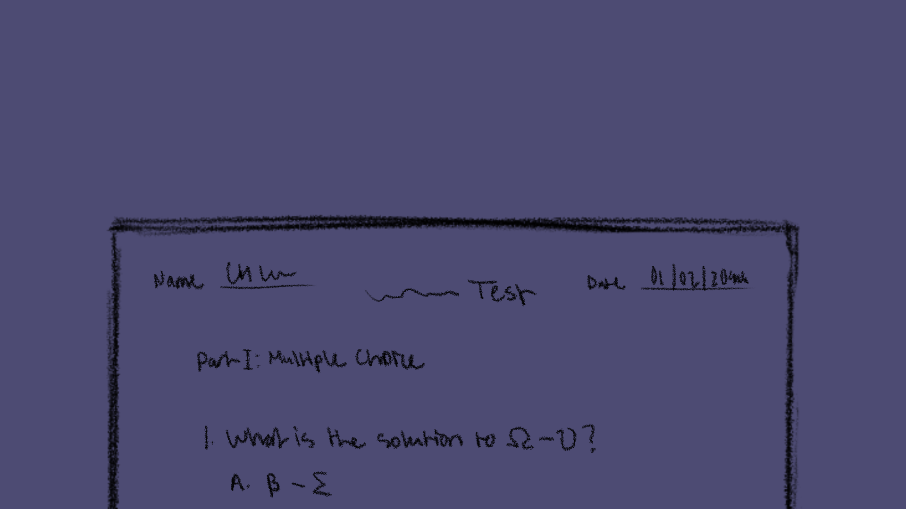
Okay.
Remember what you studied.
What?
What is happening?
focus.
I’ll just rub my eyes a bit.
I can’t
...No.
Wait.
Did we learn this?
swear
I I studied what I needed to,
so why isn’t that stuff on the test?

Slide 6

I should probably stop looking down
so mooch.
My eyelubs feel heavy.
I...I nedd..I...

Slide 7


Slide 8
Wait...
what happened?
I need to keep
Keep writing...
Did I just dream I was in class and now, I’m lucid dreaming?
writing.
but on what?
Everything’s dark.
There’s nothing to write on.
huh?
What was that?
Is that the alarm clock?
No,
please!
Let me sleep longer!

Slide 9

He looks .
WOAH!
Okay.
I’m awake now.
Wait...
today was real.
am
I in class.
No one else is, though.
Except the teacher.
mad
"Your test is blank,
and when I talked about retakes
before the test,
it was because there wouldn’t be any..."
was all I had to hear to realize what would happen..
I have to take it again next year.
I have his class.
failed

Slide 10
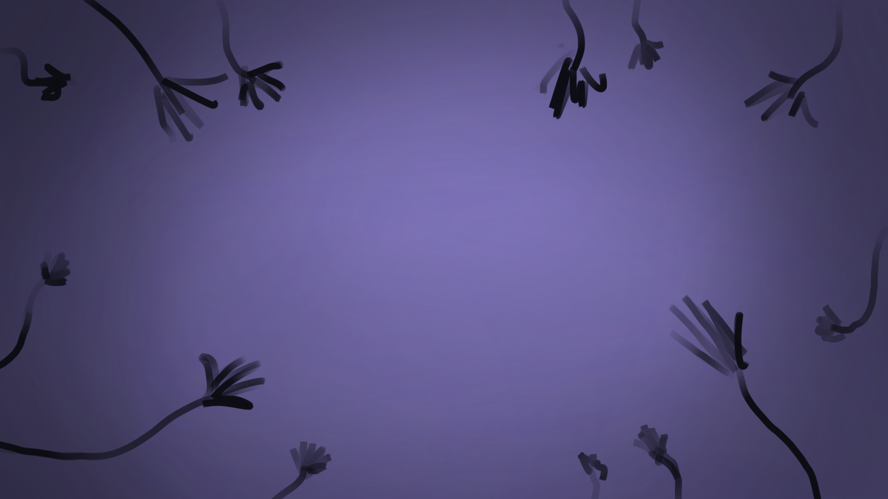
I finally left the classroom and sat outside in the hallway.
Why bother going to the last period of the day, when this is the result?
...I tried so hard.
...what am I doing wrong?

